Slide 1
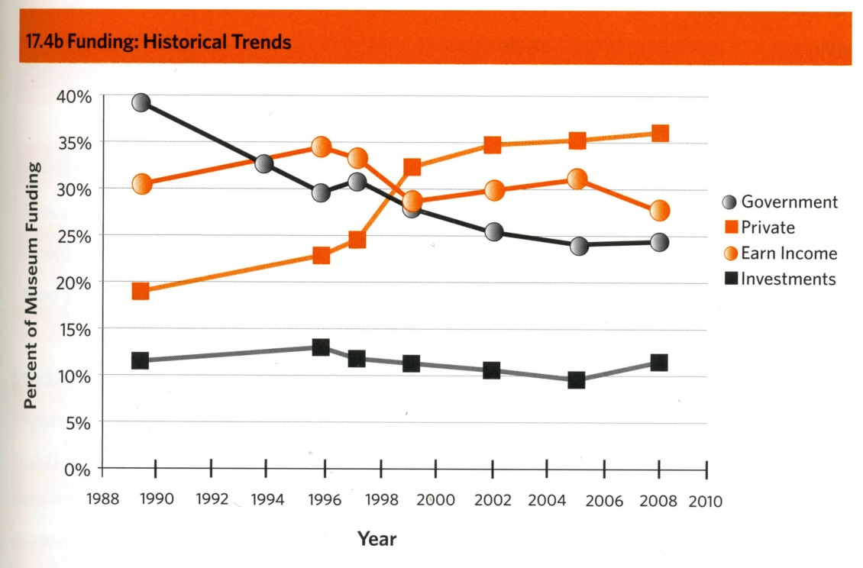
Notes:
Source: AAM 2009 Museum Financial Information

