Slide 1


CAISE Resources
Informal Commons • ISE Timeline • ICR • ISE Evidence Wiki • PI’s Guide to Managing Evaluation Wiki • Entrée
Meeting Program pg. 17

Slide 2







Association of Science-Technology Centers
Oregon State University, Free-Choice Learning Program
University of Pittsburgh Center for Learning in Out-of-School Environments
Visitor Studies Association
Ideum
The Lawrence Hall of Science
External evaluator: Inverness Research Associates
This material is based upon work supported by the National Science Foundation under Grant No.
DRL-0638981. Any opinions, findings, and conclusions or recommendations expressed in this material are those of the authors and do not necessarily reflect the views of the National Science Foundation.

Slide 3
CAISE Advisors and Reflectors
Advisors
Sue Ellen McCann, Executive Producer, KQED
Alan J. Friedman, Consultant
Julie Johnson, Distinguished Chair of Museum Leadership, Science Museum of Minnesota
Anthony “Bud” Rock, CEO, Association of Science-Technology Centers
Barry Van Deman, President and CEO, Museum of Life and Science
Reflectors
Richard Hudson, Director of Science Production, Twin Cities Public Television
Wendy Wheeler, President, The Innovation Center
Ellen Wahl, Director of Youth Development and Entrepreneurship, New York Hall of Science
Tinsley Davis, Executive Director, National Association of Science Writers
Bruce Lewenstein, Professor of Communication and Science and Technology Studies, Cornell University

Slide 4
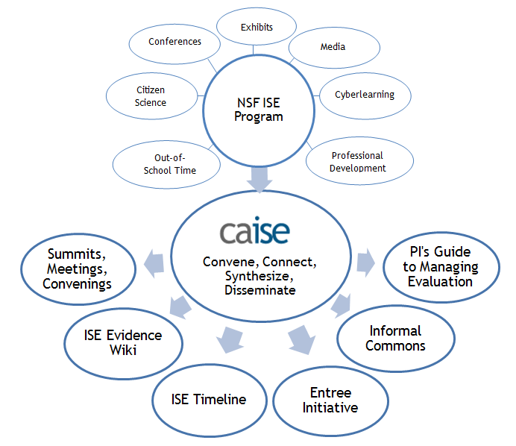
CAISE Resources are designed to benefit all sectors of the
NSF ISE portfolio.
Using input, feedback, ideas, and the collective knowledge
of ISE PIs, project staff, NSF Program Officers, evaluators, and other experts in the field, CAISE Resources address pressing needs of the field.
CAISE Resources are interactive, field-driven, and ongoing.

Slide 5
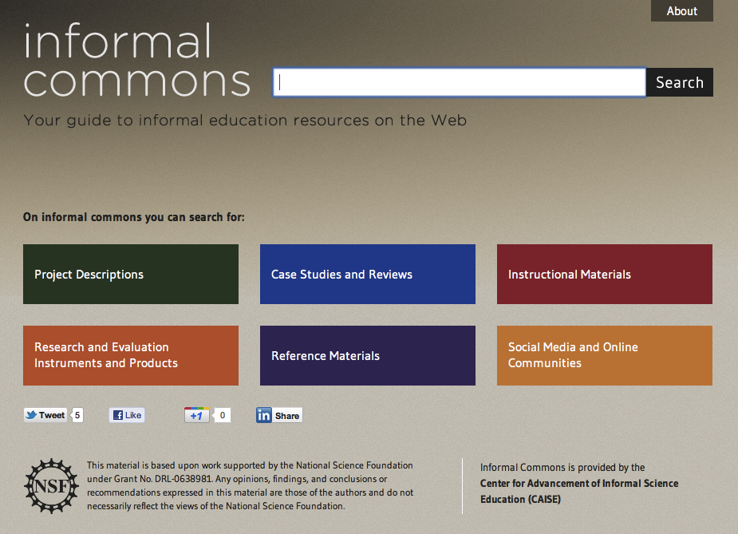

Slide 6
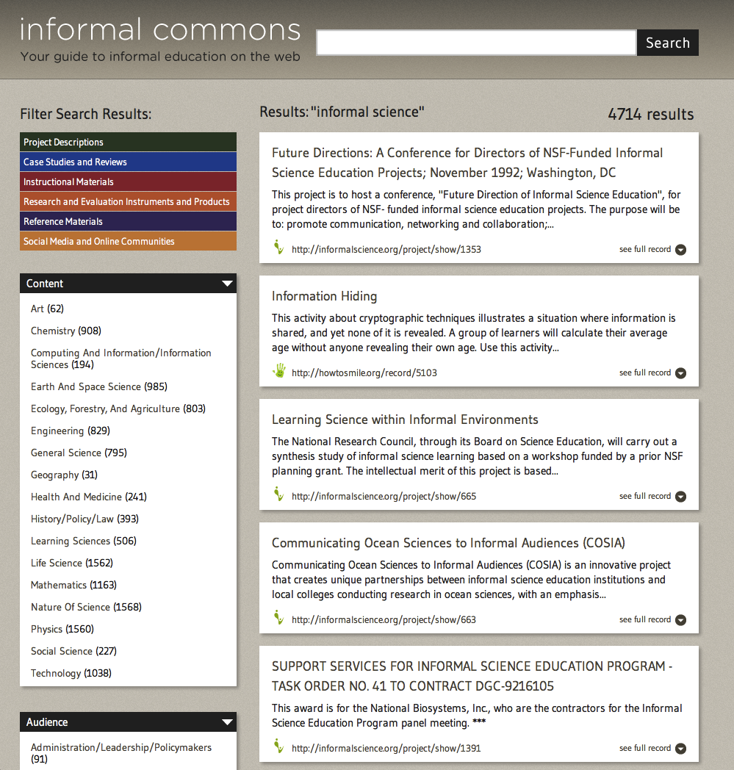
Search across sites at:
informalcommons.org
Sites include:
ASTC
ATIS
CAISE
Citizen Science
Exhibit Files
Informal Science
KQED QUEST
NAME
HowtoSmile.org
Open Exhibits
VSA

Slide 7
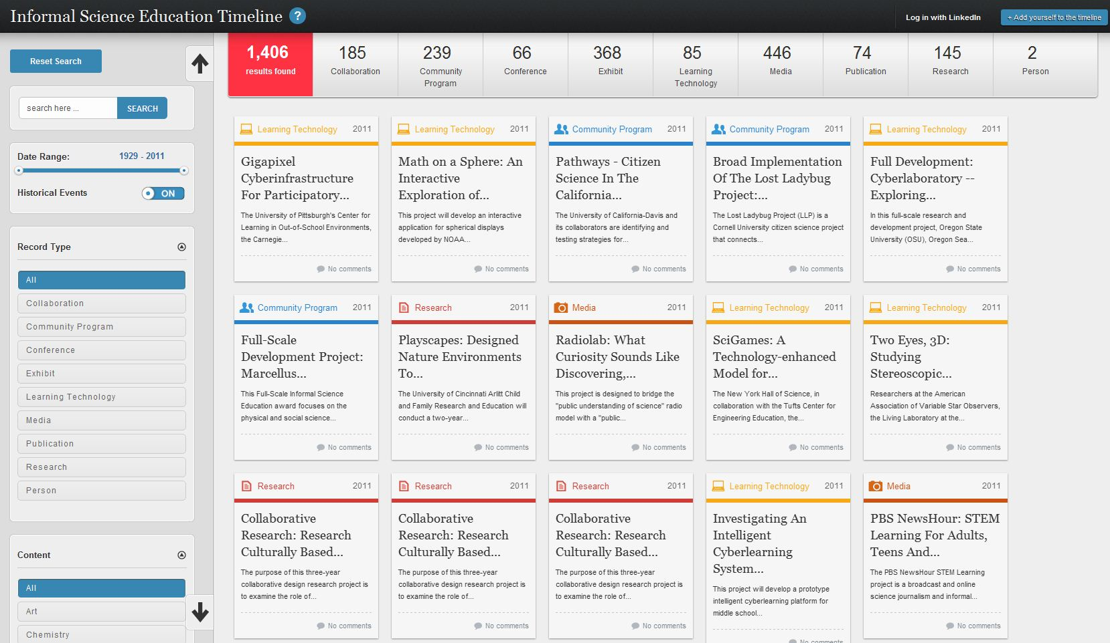

Slide 8
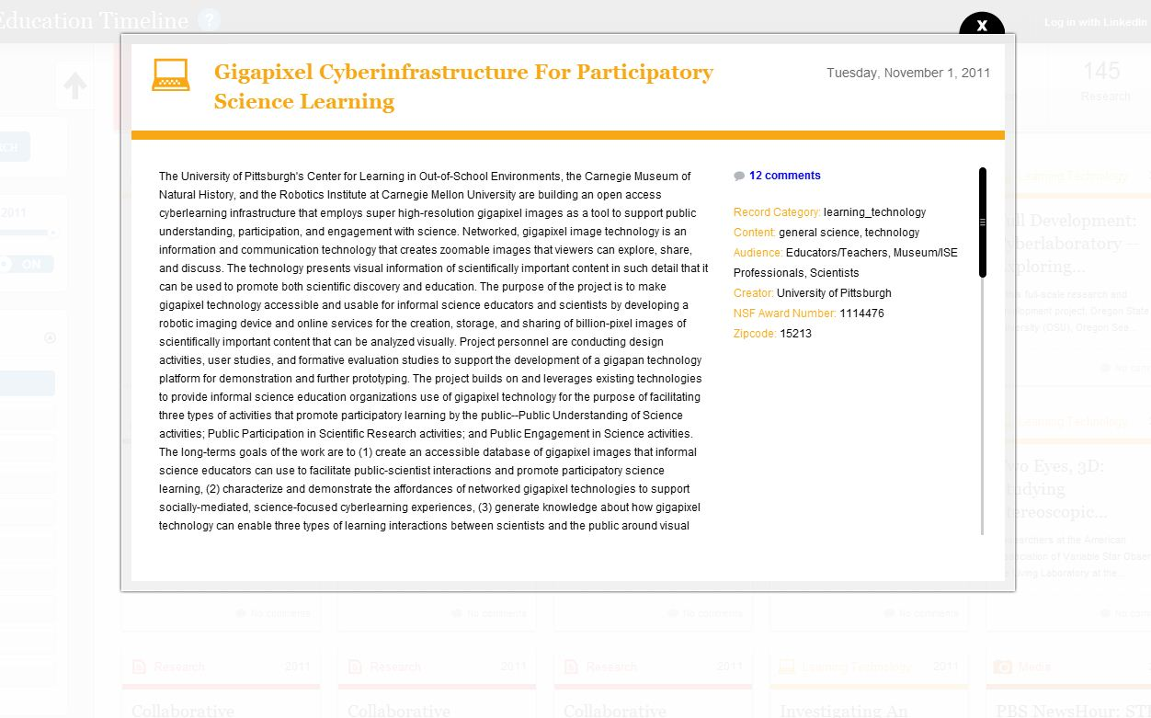

Slide 9
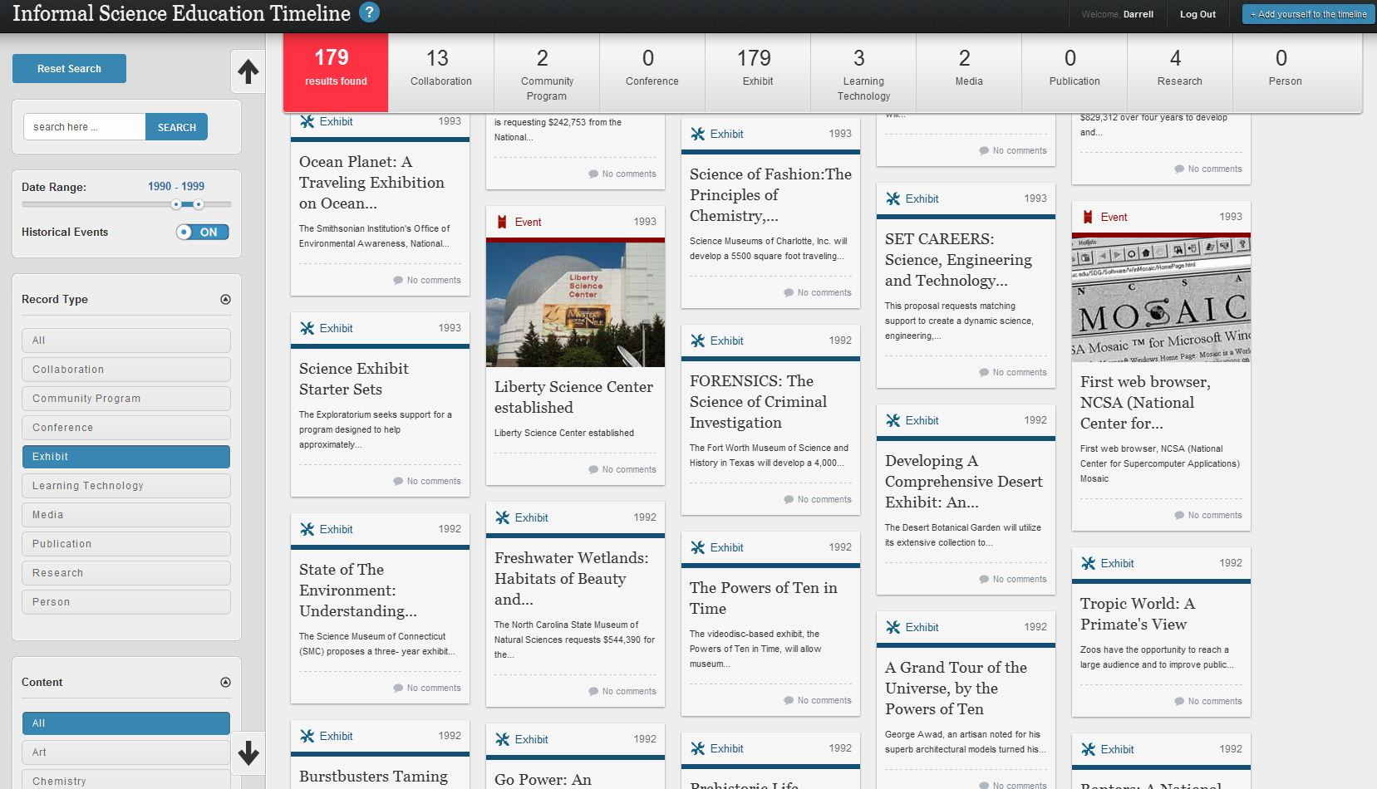

Slide 10
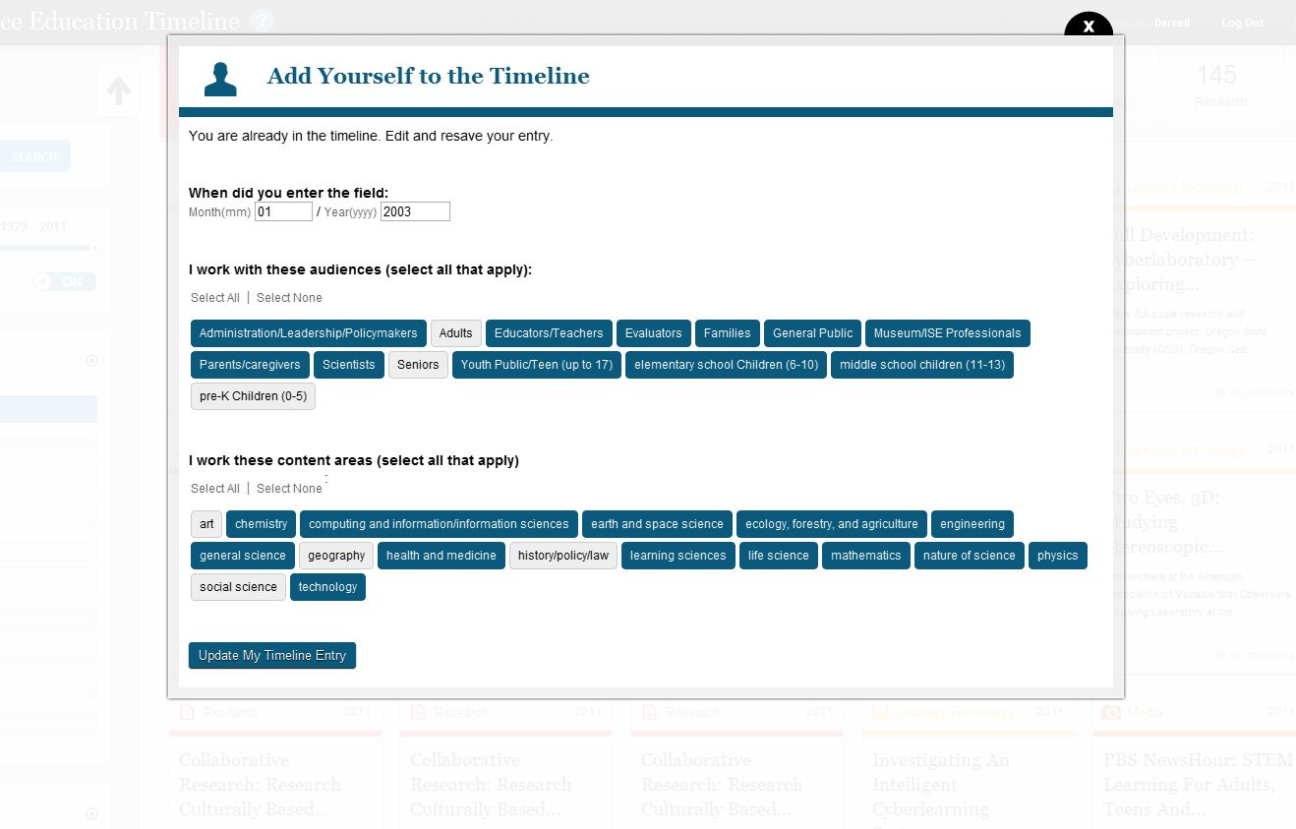

Slide 11
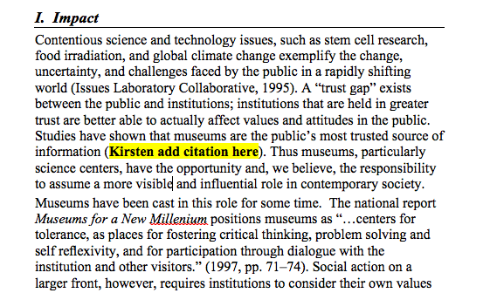

Slide 12
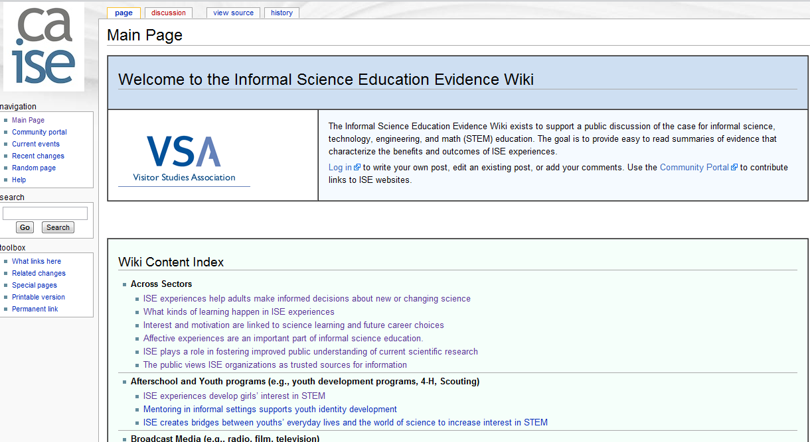
ISE Evidence Wiki
iseevidencewiki.org

Slide 13
Why and how to use an after-school program to deliver ISE
How can media be a pathway for youth and adult engagement with STEM?
Designing kids’ mobile and touch-based games for engagement and learning
How do preschool aged children learn science in a museum setting?
Adult interactions in a science museum
Educational media benefits children’s STEM learning
Best practices for designing media that improves children’s STEM learning.
Children learn more across multiple types of media and ISE experiences
How have scientists and scientific organizations become involved in the production of cinema and television?
What impact does popular entertainment, like cinema and television, have on science literacy and science education?
What impact does popular entertainment, like cinema and television, have on public attitudes towards science and in raising awareness of science?
What does research say about teacher use of field trip programs?
ISE experiences help adults make informed decisions about new or changing science
ISE plays a role in fostering improved public understanding of current scientific research.
The public views ISE organizations as trusted sources for information
How can mobile technology be used within the personal contexts of informal STEM learning?
How can mobile technology be used within physical contexts of informal STEM learning?
How can mobile technology be used within social contexts of informal STEM learning?
How might mobile technology be useful for informal STEM learning?
In what ways have citizen science programs advanced the public understanding of science and influenced public attitudes about scientific issues?
Why and how has there been a focus on integrating the arts and humanities into STEM learning?
What are the advantages and liabilities of game-based learning for informal science education?
Field Trips as Models of Authentic Scientific Processes
Impact of Media on Public Perceptions of Wildlife
Culturally Relevant Experiences in Science Museums, Zoos, and Aquariums
What impact does science journalism have on public understanding of science?
Blogging and public understanding of science
ISE organizations are trusted sources of information
Interest and motivation are linked to science learning and future career choices.
Affective experiences are an important part of informal science education
What kinds of learning happen in ISE experiences?
Insights into diverse youth engagement
Youth Centered Gardening Programs and STEM
University outreach programs make STEM accessible to diverse youth.
Exhibits engage the public in learning experiences.
Science and scientists can be made engaging to the public through exhibits.
Exhibits can be designed to increase social interaction during learning experiences.
ISE experiences develop girls’ interest in STEM.
Mentoring in informal settings supports youth identity development.
ISE creates bridges between youths’ everyday lives and the world of science to increase interest in STEM.

Slide 14
PI’s Guide to Managing Evaluation
Designed to support useful integration of evaluation into ISE projects
Audience includes current, new, and potential ISE PIs
Edited by Rick Bonney, Leslie Goodyear, and Kirsten Ellenbogen
Draft chapters are on CAISE website
caise.insci.org/activities/pi-guide

Slide 15
For many educators, evaluation is viewed as a process to be contained so that it doesn’t derail the “real work” of project completion. It’s true, evaluation takes time—but it can save you time. It also costs money—but it can save you money too. Project evaluation and implementation are interrelated endeavors, and embracing evaluation will often result in a job well done. That’s why this Guide examines how you can implement and manage evaluation to inform your practice, facilitate decision-making on project-development teams, gather evidence of success, attract further funding, and most importantly, make a difference in the lives of all the visitors and program participants whom you touch through your work.
- R. Hellenga

Slide 16
The Value of Evaluation: Why it Matters to Your Work (R. Hellenga)
Understanding Evaluation: Guiding ideas (L. Russell)
Finding an Evaluator: Matching Project Needs with Evaluator Skills and Competencies (M. Marcussen)
Supporting the Evaluation Plan: Setting Goals, Determining Indicators of Success, and Developing Evaluation Questions. (T. Phillips)
Evaluation in Action: How to Get the Most out of Working with your Evaluator (J. Luke, S. Yalowitz, & S. Palmquist)
Evaluation Results: Getting and Disseminating the Report You Need (S. Traill and R. Hellenga)
Building a Culture of Evaluation into an Institution (P. Gupta)

Slide 17
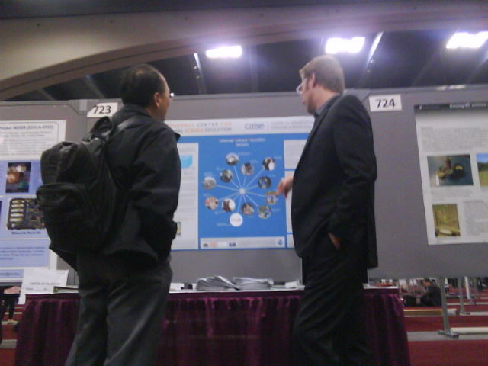

Entrée
Through a number of communication strategies, Entree provides points of access to the resources of CAISE, the NSF ISE portfolio, and the general ISE field to target audiences including current and future NSF PIs, the STEM research community and ISE practitioners.
Entrée works to build awareness of ISE and promote pathways into the field for those new to it while highlighting ISE resources to support those currently a part of ISE .
Co-PI John Falk
Director Ben Dickow
Advisor Julie Johnson
NSF Dennis Schatz and Al DeSena

Slide 18



Entrée Activities Include:
Outreach to NSF ISE PIs
• phone conversations
• email
Outreach to the STEM Research Community
• live presentations
• digital communication
• research society and NSF STEM program officer contact
Development of Specialized Web Content
for Target Audiences

Slide 19
Evaluation of Resources: Inverness Research
“First responder”/formative feedback
Interviews with ISE PIs and staff, potential PIs, program officers and CAISE reflectors
Inverness provided CAISE with feedback memos on each individual resource
Feedback has been valuable in refining these resources
THANK YOU!

Slide 20
See CAISE Resources in action at the CAISE Resource Areas in the Blue Prefunction Room throughout the meeting.
Visit caise.insci.org for more information.

