Slide 1


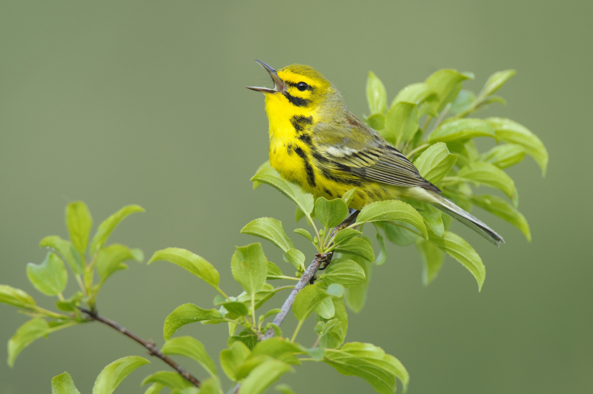

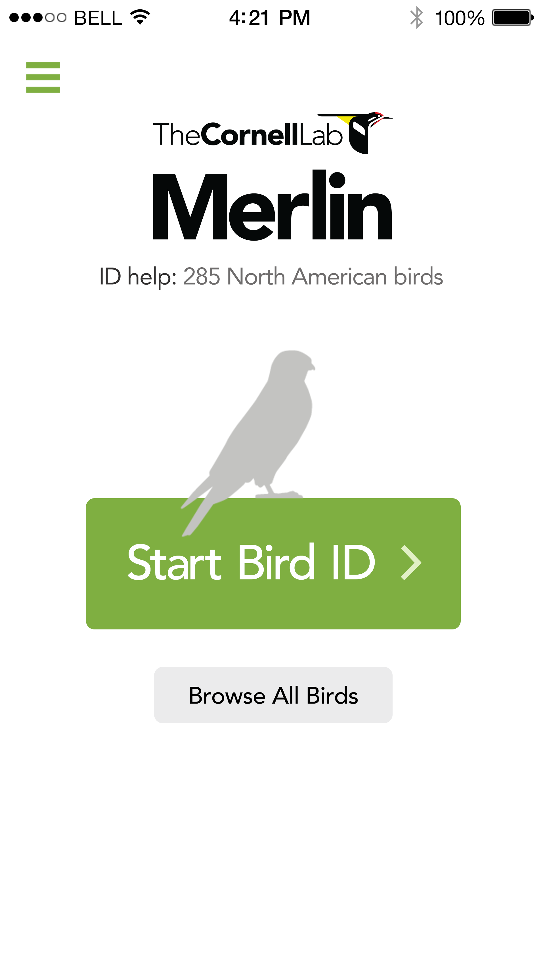
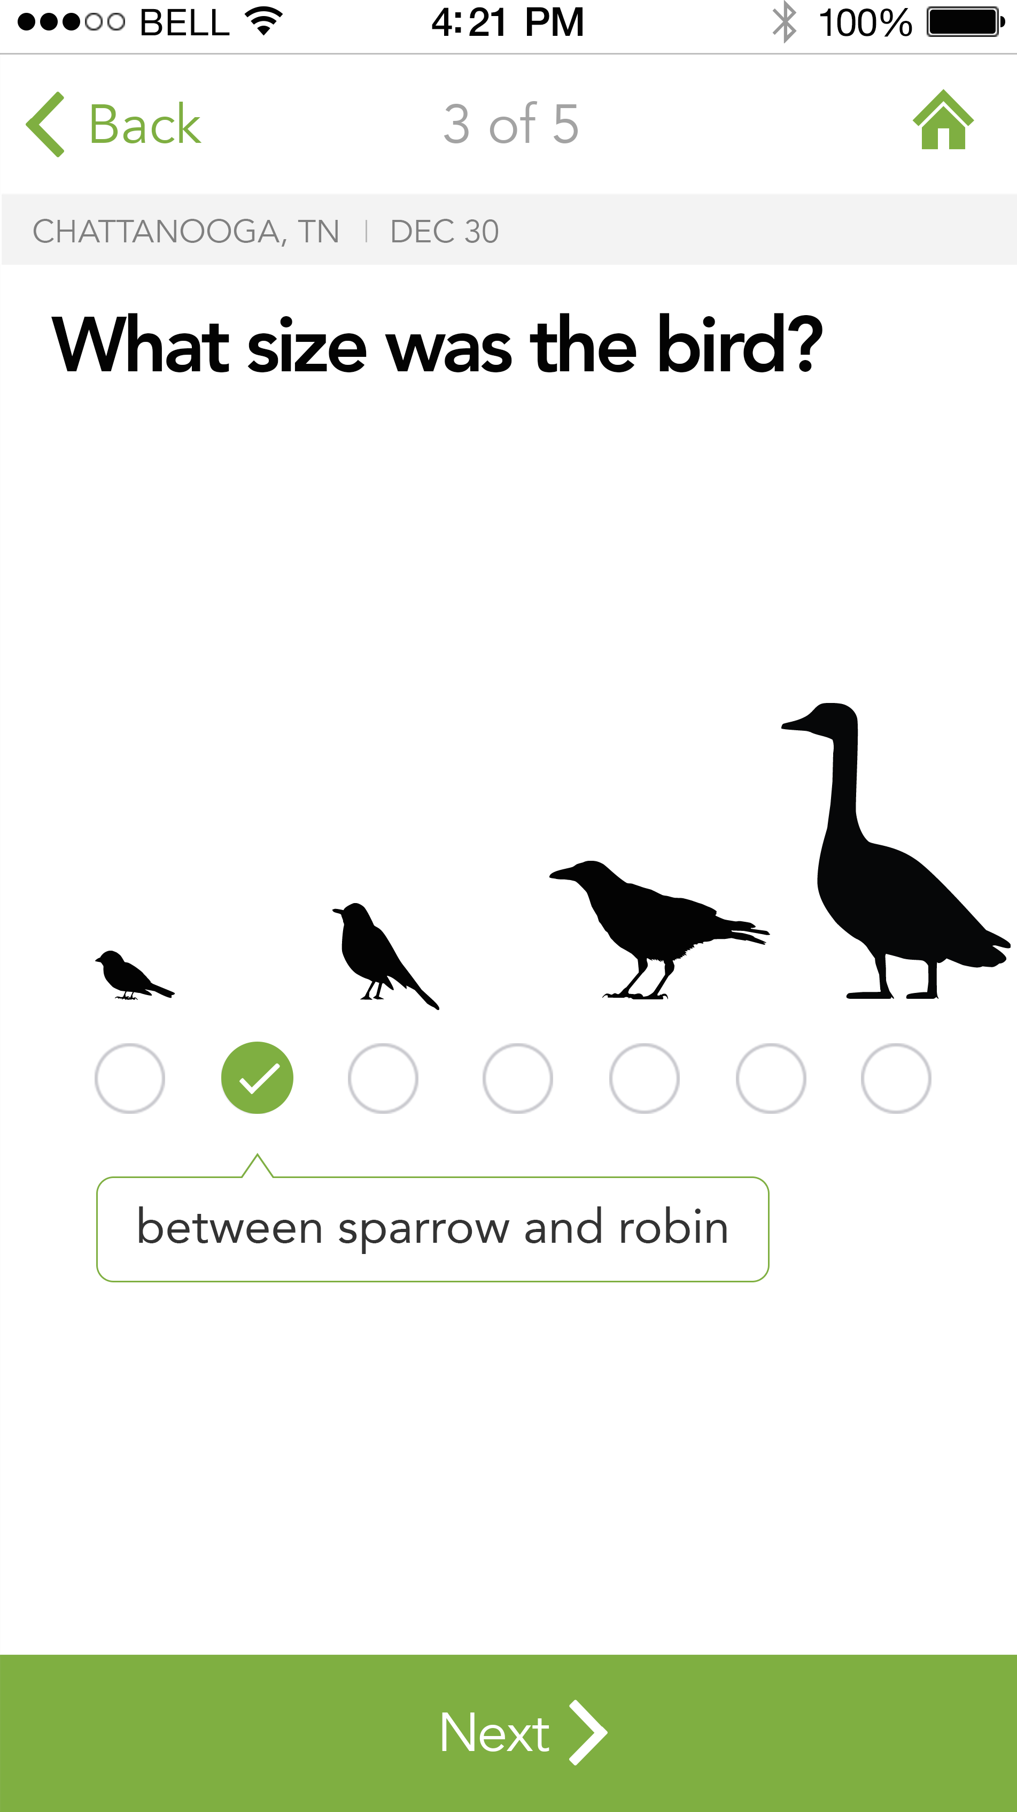
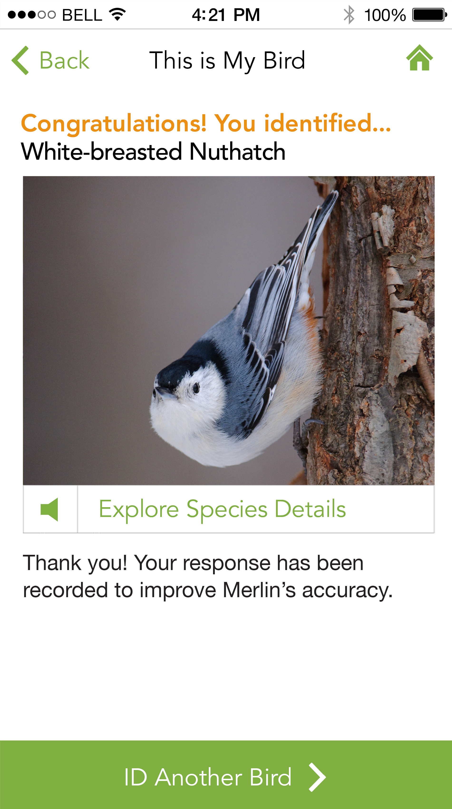
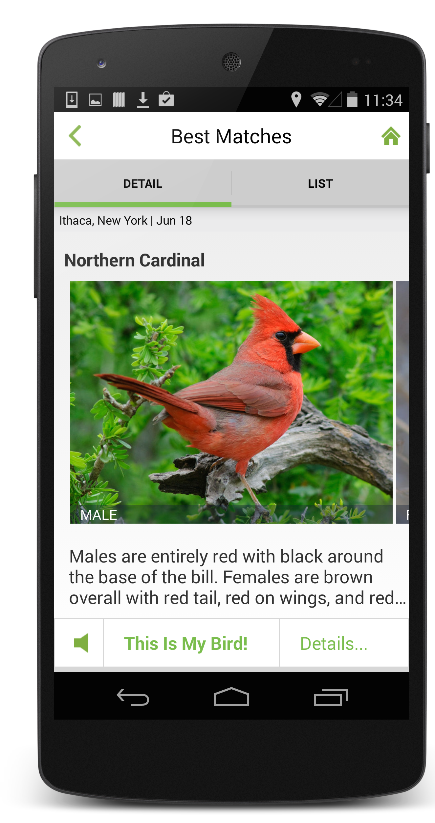
Merlin
An Online Wizard for Bird ID
What’s that bird? Answer five simple questions.
Merlin Helps You Find the Best Match
Merlin customizes your list based on the species you’re most likely to see at your location and time of year.
Merlin draws upon more than 70 million bird observations from the eBird citizen-science project and 3 million descriptors from online activities in which users “taught” Merlin how people see and describe birds.
Merlin Opens the Door for Learning
More than 2,000 photos, 1,000 audio recordings, ID tips, and maps. Merlin teaches people the names of the birds they’ve seen and encourages exploration.
Summative Evaluation
Evaluation is underway to assess the extent to which Merlin helps people identify birds, improve observation and identification skills, increase their knowledge of birds, and engage in bird-watching activities and stewardship. The audience is self-identified beginner and novice birders.
230,000 downloads since January!
“I love this app. I never noticed what birds we have right in our backyard. “
“This app makes watching birds exciting--I thought they were all sparrows!”
Prairie Warbler By Gerrit Yvn
Principal Investigator Miyoko Chu, Co-PI Rick Bonney, Evaluation Manager Tina Phillips (Cornell Lab of Ornithology). External Evaluator Kate Haley-Goldman (Audience Viewpoints)
AllAboutBirds.org/MerlinApp
“Great App. This app makes watching birds exciting--I thought they were all sparrows!”

