Slide 1
Nuts & Bolts of Award Management March 14, 2012
ISE PI Meeting
Division of Grants and Agreements

Slide 2
Speakers
Angela Turner - Grant and Agreement Specialist – 703-292-7524 – aturner@nsf.gov
POC: Laura Buckley – Grant and Agreement Specialist – 703-292-4817 - lbuckley@nsf.gov

Slide 3
Topics Covered
NSF Award Management Philosophy
Award Administration Roles
Types of Awards
Award Notification
Award Revisions: Awardee approval vs. NSF approval
Participant Support
Subaward Monitoring
Consultants
Project Reports
Audit Requirements
Termination & Disciplinary Actions
Accessing Documents on the NSF Website
Conclusion
Notes:
These are the topics we are going to cover today. Please feel free to ask questions during this presentation. The Division of Grants and Agreements are here to help.

Slide 4
DGA Award Management
DGA’s mission
The Division of Grants and Agreements (DGA)
supports the issuance of NSF assistance awards and other agreements by providing business, financial, and award administration assistance from pre-award through closeout.
Program provides oversight of scientific progress
DGA along with our Cost Analysis Branch provides oversight of compliance and business assistance
Audit responsibility and investigations reside with OIG
Notes:
The awardee has the responsibility of conducting the research.
*End-to-end
NSF will follow (manage) the award from the beginning (proposal stages) to the end (closure) of the award.

Slide 5
Award Administration Roles
Awardee:
Ensures that actions:
Are consistent with award terms and conditions.
Are consistent with NSF and awardee policies.
Represent effective use of resources.
Avoid any significant project changes.
NSF:
Provides minimal monitoring.
Notes:
While you are in the middle of your project you want to ensure that nuts and bolts are being applied so that everything will run smoothly. While using your wrench you have to apply the award terms and conditions.
NSF provides a small amount of monitoring on awards agreements.

Slide 6
Award Notification
Grants
Award Notice, Research Terms & Conditions,
Research Terms and Conditions (RTCs), occasional
special conditions, and other documents incorporated by reference
Electronic dissemination of Award Notice to AOR (Office of Sponsored Research)
Awardee Distribution of Terms & Conditions
Also available electronically via FastLane
Notes:
Grants
Read your award letter. Please make sure the PI, Sponsored Research have a copy of the award letter. Your award letter and any actions submitted through Fastlane can be viewed in Fastlane.

Slide 7
Award Changes with Awardee-Authorized
Approvals
Notification to NSF is NOT required for:
Virtually all budget changes
Budget changes are the PI’s prerogative and are subject to organizational approval
Exception: when budget changes alter the objective or scope
Exception: when budget changes alter participant support costs
90 Day Pre-Award Costs
Notes:
You have the power!
The PI can authorize budget changes but are subject to the organization’s approval.
You can find this information in the Proposal and Award Policies and Procedures Guide in Exhibit II-1.

Slide 8
Award Changes Requiring
NSF Notification
Notification to NSF IS required for:
Single 12 Month No-Cost Extension
Does not include awards that contain a zero balance
Significant changes in methods & procedures*
Unusual occurrences*
Short term absences (less than 90 days)*
Conflict of interest not handled by awardee
* Note: These three items require that the PI send notification to NSF via Fastlane, with a copy to the AOR.
Notes:
You can go into Fastlane and extend the award, and receive a Grantee No-Cost Extension, if this is your first No-Cost Extension.

Slide 9
Award Changes Requiring
NSF Prior Approval
(Technically Related)
NSF prior approval is required for:
Change in objective or scope
Change in expiration date (no-cost extension)
PI/co-PI changes:
Withdrawal or change of PI/co-PI
Long-term absence: defined as 90 days or more
Reduction on PI level of effort: defined as a reduction of 25% or more in time devoted to the project

Slide 10
Award Changes Requiring
NSF Prior Approval
NSF prior approval is required for:
Transferring and project effort:
Via sub-award
Transfer of the award to a new organization (“PI Transfers”)
Reallocation of participant support
Alterations and renovations over $25,000 (Construction)
Change in cost sharing amount identified on Line M of the cumulative award budget
Pre-award costs more than 90 days prior

Slide 11
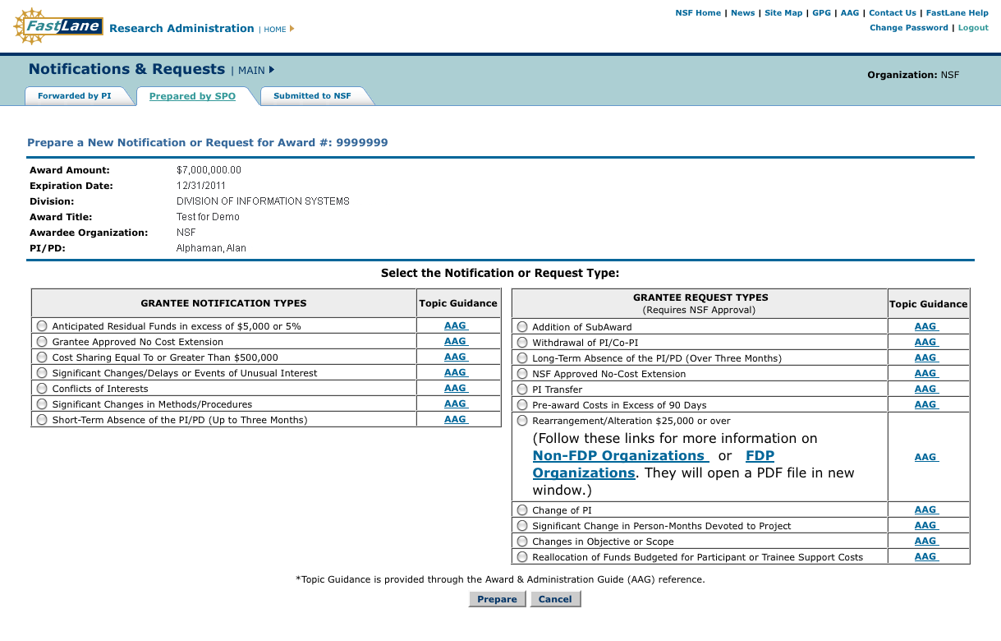
Submit Notifications
& Requests via FastLane
Notes:
Do we have any PI’s in the room that use Fastlane?
When your Sponsored Research Office goes into Fastlane to request prior approval for some of the – this is what Fastlane looks like.

Slide 12
Participant Support
Participants or Trainees (not employees – exception school districts – teacher training)
Stipends, subsistence allowance, travel, registration fees, copies, tuition
Funds may not be re-budgeted to other expense categories
with out prior written approval of the NSF program officer (via
FastLane)
Notes:
Before spending from the participant support category, be sure you are following your institution’s written policies and procedures.

Slide 13
Participant Support
Awardee organizations must be able to identify participant support costs.
Participant Support Costs are not a normal account classification
Highly recommended that separate accounts, sub-accounts sub-task or sub-ledgers be established accumulate these costs.
Should have written policies & procedures

Slide 14
Participant Support
Typically excluded by NSF from application of the indirect cost rate
MTDC – and pass through funds – such as stipends
Participant support – eligibility
– what did participants have to do to receive the payment
Documentation of attendees at conferences or workshops
Reference: GC-1, Article 7 OMB Circular A-21, J.17 and J.48
Notes:
(MTDC) Modified Total Direct Cost
Participant Support-
What are the requirements for participants? What are the eligibility requirements established for your institution?

Slide 15
GRANTEE DRAW DOWN OF FUNDS
NSF grantees are required to have financial management systems that meet the requirements of Section .21 of OMB Circular A-110. (2 CFR §215.21)
Cash Request Function - used by grantees to request funds. (See AAG Chapter III.C.1)
Grantee EFT Update Function - used by grantees to provide NSF with their banking information. (See AAG Chapter III.C.6-)

Slide 16
GRANTEE DRAW DOWN OF FUNDS
NSF's grantees (see AAG Chapter III.C.4) are required to request payments electronically through the FastLane Cash Request Function.
Federal Financial Report Function - electronic version of the standard “Federal Financial Report”. Used by grantees to report the financial activity of NSF awards on a quarterly basis. (See AAG Chapter III.E.1)

Slide 17
GRANTEE DRAW DOWN OF FUNDS
Grantee Electronic Funds Transfer
(EFT) Update
This system enables NSF to transfer funds electronically to a grantee’s bank account by using the banking information provided by the grantee.

Slide 18
GRANTEE DRAW DOWN OF FUNDS
The grantee’s designated official (Accounting Officer, Business Officer, Treasurer, etc.) must submit their cash requests for payment by using the FastLane Cash Request System.
Grantees submit requests on a periodic basis (monthly, biweekly or other regular cycle) depending on their normal disbursement patterns. Such requests should be limited to the minimum amounts needed and be timed to meet the anticipated cash requirements for allowable charges to active NSF projects.

Slide 19
Sub-awards & Sub-Recipient Monitoring
Characteristics indicative of a Federal award received by a sub-recipient :
Performance is measured against
objectives of the Federal award being met
Responsibility for programmatic decision making
Responsibility for adherence to applicable Federal program compliance requirements
Notes:
You have the NSF award and it has been established that a sub-award is required. As you the Prime-Awardee, begin making your selection you, have the responsibility of determining the reasonableness of cost that the sub-awardee is planning to charge the award.
Since you do not have authorization to enter into a sub-award agreement from NSF you must first obtain approval through Fastlane by submitting the proper documentation.

Slide 20
Prime-Awardee Responsibilities
Ensures that the subawardee:
Has ability to perform both technically and administratively
Has financial capability
Has appropriate indirect cost rate & base
Has No Debarred or suspended PIs (reference Excluded Parties List -- EPLS.gov)
Notes:
During your process of sub-awardee selection be sure to perform these checks.

Slide 21
Subrecipient OMB A-133 Audits
The Awardee receives OMB A-133 audit reports
or accesses Federal Audit Clearinghouse
http://harvester.census.gov/sac/
Resolves those findings that apply to your subcontract, if any

Slide 22
NSF Expectations
Systems are in place for monitoring sub-recipients – “risk based approach” is encouraged
Awardee completes Technical, Financial, and Compliance reviews of Subawardees

Slide 23
Consultants
Members of particular profession or possess
certain skill;
Technical advice & support
work under awardee organization’s direction
generally not responsible for a deliverable
Reasonableness of consultant rate of pay
Rates should be comparable to the normal or customary fees charged
Notes:
Consultants are members of a particular profession or possess a certain skill.

Slide 24
Consultants- Agreement
Name of Consultant
- Business or organization
Rate of pay
Period of performance
Description of service to be provided
Cost information on: - travel (per diem rates), supplies other expenses
Consultants- Invoice
Rate charged and time worked - hourly or daily rate
Short description of services provided
Include all hours - (example - preparation time & response time for speakers)
Notes:
These items should be listed in your consultant agreement.

Slide 25
Required Technical
Reports
Annual Project Reports
Due 90 days prior to the current expiration date of the award
Required for ALL Standard & Continuing Grants
Final Project Reports
Due within 90-days after the expiration of an award
Required for ALL Standard & Continuing Grants and

Slide 26
Required Technical
Reports
Reports contents include:
Participants
Activities & Findings
Publications & Products
Contributions
Special Requirements
Carryover of funds (provide circumstance to NSF Program Officer
Technical Monitoring
Program Officer site visits
Participation in required outreach activities
Notes:
The annual projects reports require the following contents.

Slide 27
Consequences of Overdue Annual/Final Reports
No future funding
No PI changes or no-cost extensions
No changes after final report approval by PO
PO can return final report up to 30 days after approval date
Report status can’t be re-set for annual reports
Notes:
Please submit all annual project reports on time. Outstanding/Late reports at NSF stops the processing on any of your other awards, if you are a Co-PI you are also holding up that project.

Slide 28
Project Reporting Facts
Extending the grant period does not relieve PIs
of reporting requirements.
In the last year of a grant, the PI owes only a final report.
Final report submission means final action – no further activity is allowed.
The organization is responsible for submission of required reports; not the PI.
If the PI leaves prior to submitting a required report, the organization must still fulfill reporting obligations.
Reports cannot be submitted prior to period start date.
Notes:
If you receive a no-cost extension. You are required to submit an annual report for what would’ve been the final year report, and final report would be due at the end of the extension.
There has been some confusion out there over this one. The final year of the award requires you to submit a final report.
Just because the PI leaves does not absolve you of your requirement to submit a report. Talk to your program officer or grants officer.
The award is made to the institution, not the PI…

Slide 29
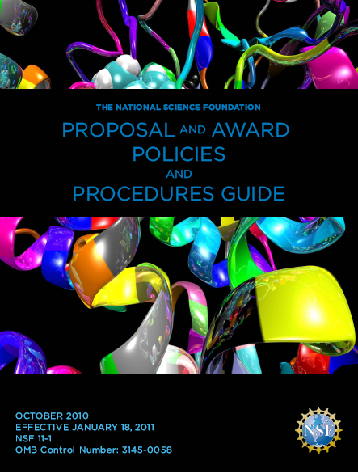
Audit Requirements
Research Terms & Conditions (RTC)
Article 26
Grant General Conditions (GC-1)
Article 23
Award & Administration Guide (AAG)
Chapter II.F
NSF Office of Inspector General Activities
Notes:
Notice the Proposal and Award Policies and Procedures Guide, you want to keep this near. You can easily find these tools at NSF’s website.

Slide 30
Award Suspension &
Termination
The award may be suspended or terminated in whole or in part in any of the following situations:
By NSF when:
The awardee has failed to comply with the terms and conditions of the grant.
The Foundation has other reasonable cause.
It is ordered by the Deputy Director under NSF’s Regulation on Research Misconduct (45 CFR &689).

Slide 31
Award Termination &
Disciplinary Actions
By NSF when (Continued):
NSF and the awardee mutually agree that termination would be in both parties’ best interest.
If NSF and the awardee cannot reach an agreement, NSF reserves the right to unilaterally terminate the grant.
By the awardee:
Via written notice to NSF.

Slide 32
Nuts & Bolts of Award Management
Effective Communication
Know requirements (award letter, award terms and conditions, OMB Circulars)
Good accounting practices – accumulation & segregation of costs

Slide 33
Need More information?
NSF home page:
http://www.nsf.gov

Slide 34
QUICK REFERENCE LINKS
http://www.nsf.gov/pubs/policydocs/pappguide/nsf11001/nsf11_1.pdf Proposal &Award Policies & Procedures Guide
http://www.nsf.gov/bfa/dga/index.jsp Division of Grants and Agreements
http://www.nsf.gov/bfa/dfm/index.jsp Division of Financial Management
http://www.nsf.gov/bfa/dias/caar/index.jsp Cost Analysis & Audit Resolution Branch
www.whitehouse.gov/OMB/circulars/ OMB Circulars

Slide 35
Ask Early,
Ask Often!

