Slide 1
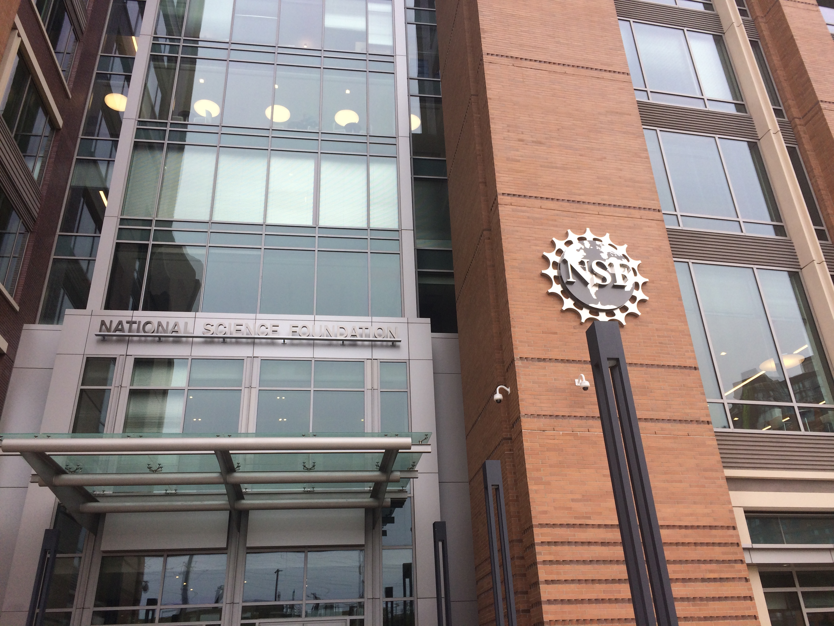
Welcome to...
Writing Competitive Proposals
For the Advancing Informal STEM Learning
(AISL) Program
Robert L. Russell & Catherine Eberbach,
AISL Program Officers
AISL, Division of Research on Learning, EHR

Slide 2
Webinar At A Glance
Overview of AISL Program
Reviewers & The Review Process
How to Present Your Project
What to Say in 18 pages
Research & Evaluation
Avoiding Fatal Flaws
Q & A

Slide 3
AISL Program
Advancing – Innovative projects that advance the field through building knowledge via innovative approaches and research.
Informal – Out-of-School learning that makes learning lifelong, life wide, & life deep.
STEM – Not just focused on science, but all of NSF-funded STEM Fields.
Learning – Learning outcomes include: interest, engagement, motivation, behavior, identity, persistence, understanding, awareness, knowledge, and use of STEM content and practices, and 21st century skills.

Slide 4
AISL Projects: Overview
13-608 p.4
Build on fundamental research and STEM education development literature and practice
Advance the field through the development of innovative research, assessment, resources, models and tools
Have rigorous research and development plans
Generate knowledge through research, development, & evaluation, asking “what is happening,” “to what extent,” “why,” “how,” “what works for whom,” and “under what circumstances”
Identify learning outcomes
Audience: Public and/or Professional
4

Slide 5
Project types
13-608 p.4
Pilots/Feasibility Studies: Exploratory development work or feasibility studies
Research in Service to Practice: Advances knowledge & provides evidence base for practice
Innovations in Development: Builds knowledge through the development of innovative products
Broad Implementation: Expands models, programs, technologies, assessments, or other advances
Conferences, Symposia: Focus on communities of practice, field-advancing practice, assessments, & research agendas
Literature Reviews, Syntheses, Meta-Analyses
5

Slide 6
Considering Your Reviewers
The Review Process
Merit Review Criteria
Who are the reviewers & what do they do?
How should you present your project?

Slide 7
Proposal Review Process and Timeline
DGA
Organization
submits
via
FastLane
Program
Officers
Ad hoc
NSF
Program
Advise
Recommend
Division
Director
Concur
Award
Panel
Decline
Organization
Proposal Receipt
at NSF
DGA
Award
DD Concur
6 Months
30 Days

Slide 8
NSB Report on Merit Review Criteria: Two Review Criteria
When evaluating NSF proposals, reviewers consider what the proposers want to do, why they want to do it, how they plan to do it, how they will know if they succeed, and what benefits would accrue if the project is successful. These issues apply both to the technical aspects of the proposal and the way in which the project may make broader contributions. To that end, reviewers evaluate all proposals against two criteria:
Intellectual Merit: The intellectual Merit criterion encompasses the potential to advance knowledge; and
Broader Impacts: The Broader Impacts criterion encompasses the potential to benefit society and contribute to the achievement of specific, desired societal outcomes.

Slide 9
Who are the panelists?
Panelists belong to a wide mix of academic communities:
Scientists
Education & Learning researchers
Informal education practitioners (museums, science outreach programs, etc.)
University administrators

Slide 10
How much work does a reviewer do?
A LOT!!!!
No more than 12 proposals per reviewer.
Proposals are sent to panelists about one month in advance.
Reviews are entered into Fastlane.

Slide 11
How to Present Your Project
Proposal writing vs. academic writing
Terminology
How to make your proposal reviewer friendly
Tone & Content

Slide 12
Understand the Genre
Grant proposals are a very specific genre of academic writing
Similar but not the same as research articles (e.g., not simply blind judgment of intellectual merit).
Important Differences:
Not blinded (the person behind the proposal does matter)
Relevance beyond the research world
Projection of future research (not retrospective reporting)

Slide 13
Do not presume shared knowledge/terminology
Reviewers come from diverse research/ discourse communities.
Reviewers can feel overwhelmed by the massive amount of information in the proposals.
Avoid assuming that they share your:
specialized knowledge
technical vocabulary
Can lead to cognitive overload

Slide 14
Get to the point!
Reviewers should be able to easily get a sense of what the proposal is about upfront (project summary and introduction).
Make what they are looking for easy to find, using the language of the review criteria and headings to highlight the elements of the project description.

Slide 15
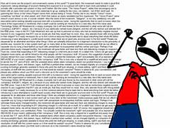
Use a Reviewer-Friendly Format
An easy-to-follow format can go a long way:
Use same labels as those used in the call.
Use bold and leave some blank space (indentations).
Include some figures/diagrams.
Clearly structured texts are less overwhelming for readers.
Although space is limited (18 pages), an excessive number of words per page does not necessarily make your proposal stronger!

Slide 16
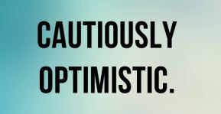
Mind your Tone
“The meek shall not inherit the grants” (Myers, 1990)
Try to project a positive image of the intended research, but also a positive “self image” (as a competent/confident yet careful researcher).
Applicants can come across as arrogant and unrealistic.
Understatement and toning down one’s language not to over-claim the importance of the work is recommended. (Your project is probably not “the only” or “the first.”)

Slide 17
In terms of Content
Do not just “give lip service” to the issues being raised.
Explicit statement about how the proposal addresses the goals of the AISL program.
Have a colleague (not involved in your project) give your proposal a critical read.

Slide 18
What to Say in 18 pages

Slide 19
Before You Begin Writing
Do your homework:
Familiarize yourself with the NSF website.
Download a copy of the NSF Proposal & Award Policies & Procedures Guide (PAPPG). https://www.nsf.gov/pubs/2013/nsf13127/nsf13127.jsp
Read the solicitation carefully and multiple times.
Check the NSF Awards Search Page for examples.
Visit the CAISE website, which is the AISL program resource center and network.
Talk to NSF Program Officers about your ideas:
Schedule a call with a PO.
POs may ask you to send a 1-2 page summary in advance.

Slide 20
Project Summary
One page maximum
First Sentence
Type of Proposal (Project Type)
A general description of the project to be designed, implemented, and evaluated.
Intellectual Merit and Broader Impacts
Must include separate statements on each of these two NSB criteria

Slide 21
Project Description Should Include…
Project overview and rationale
Project goals and objectives
Summary of effectiveness and impact of prior support
Explanation of principles that guided the project design, informed by the literature [Theoretical Framework]
Description of intervention, learning environment (e.g., game, exhibit, experiences, media, etc.), or context of research
Intervention/Learning Environment
Anticipated results
Research questions and plan
Plan for independent review of project progress and success of implementation [Project Evaluation, formative and summative]
Dissemination plan [Identify constituencies and how you will communicate findings to them]
Management, Qualifications of key personnel who will coordinate the project

Slide 22
Overview/Rationale: What Makes This Project Important?
How is it innovative or potentially transformative?
How will it advance knowledge and move the field forward?
What are the anticipated outcomes or products of this project?
Who will be interested in these outcomes, and how will you target dissemination of findings to them?
How might these products or findings be useful on a broader scale?

Slide 23
Theoretical Framework: What Have You And Others Done?
Describe the theoretical and research basis on which the proposal is based.
How has the prior research influenced this project?
Discuss how the proposal is innovative and different from similar projects.
If you have previously been funded by NSF for similar work, provide evidence about the effectiveness and impact of that work.

Slide 24
Results of Prior Research
Does this project build on the results of related prior projects by the PI’s?
If yes, is there evidence provided about the intellectual merit and broader impacts of the prior project(s)?
How has the prior project influenced this project?

Slide 25
Description of Intervention/Learning Environment
Provide an overview and concrete details on the informal learning environment and related participant experience.
The learning environment can be an exhibit, game, media production or other informal STEM learning experience that provides the opportunity for the project’s research.
An overview of the learning environment helps reviewers understand how and why it has the potential for research the experiences, learning processes, and impacts hypothesized in your proposal.

Slide 26
Dissemination: How Will Others Learn About The Project?
Plan specific strategies for Dissemination of products or findings to researchers, policy makers, practitioners, and other relevant constituency groups. Identify the relevant groups.
Applicants are encouraged to bring the same levels of insight and creativity to the dissemination aspect of their proposal as they do to their educational research and development design.

Slide 27
Staffing/Management: Who Will Do the Work?
Briefly describe the expertise of the persons included on the proposal and why they are needed:
Education/Learning researchers and evaluators
Teachers and/or practioners
Community and/or industry
STEM-related content experts
How will the project team & collaborating organizations work together
Upload two page bios for all senior personnel
Include the mentoring plan if Post-Docs are involved.

Slide 28
Research & Evaluation
Research & Evaluation in AISL proposals emphasize knowledge building capacity.
The Merit Review elements require that proposals include mechanisms: 1) for iterative improvement, and 2) to assess success.
Both research and evaluation can be used to support these purposes.

Slide 29
Research & Plan Elements
AISL supports research that advances knowledge and the evidence base for practices, assumptions, broadening participation, or emerging educational arrangements in STEM learning in informal environments, including the science of science communication.
Contextualize the research in prior work.
State clear, focused research questions & hypotheses that the project will investigate.
Describe the theoretical framework, research methods, including data sources, sampling, analyses, and assessments.
Describe the plan for developing, modifying, or implementing the proposed innovation.
Describe the work plan and timeline.
Strong research/practice collaborations

Slide 30
Common Guidelines for Education Research & Development
You are encouraged to be familiar with the Common Guidelines for Educational Research and Development—specifically the NSF FAQs—in the preparation of proposals. https://www.nsf.gov/pubs/2013/nsf13127/nsf13127.jsp
The Guidelines describe research types that are most relevant for AISL projects, including: Foundational, Early Stage or Exploratory, and Design and Development Studies.

Slide 31
Evaluation in AISL Proposals
All AISL project proposals are required to specify the external review and evaluative processes they would be used to achieve the following goals:
Support iterative improvement. Evaluative processes should ensure that a project gets appropriate, rigorous, external input throughout the life of the project. Such input is essential for project monitoring, management, and continuous quality improvement. External feedback should enrich (and potentially challenge) teams’ perspectives.
Promote accountability. Evaluative processes should address questions such as: Is the project addressing its stated goals? What is the quality of the work?

Slide 32
What Evaluation is About
The objectives of the evaluation include:
Recommending evidenced-based adjustments to project plans.
Determining the effectiveness and impact of the products or processes.
Attesting to the integrity of outcomes reported by the project.
Assessing whether the project is making satisfactory progress toward its goals.

Slide 33
Project Evaluation Elements
Proposals should describe critical features of the evaluation design:
Evaluation questions
Data to be gathered & Sampling methods
Data analysis plans
Expertise of those responsible for evaluation.
Proposals should distinguish evaluation from other critical research components. This does not mean that research & evaluation have no relationship.

Slide 34
Avoiding Potentially Fatal Flaws

Slide 35
Common Reasons for Return Without Review
Violation of formatting rules of the PAPPG (e.g. font, page length etc.). https://www.nsf.gov/pubs/2013/nsf13127/nsf13127.jsp
Failure to address specifically intellectual merit and broader impact in the project summary and description.
Failure to include Data Management Plan or Post-Doc mentoring plan (if budget includes post-doc)
Including unauthorized appendix or other supplementary material.
Including URL’s/website links.

Slide 36
Common Reasons Proposals are Rated Non-Competitive
Importance
Proposed problem not seen as nationally important.
Weak, vague, or no connection to STEM content.
Relevant literatures not cited, weak or no theoretical framework.
Methods
Inadequate or inappropriate research design.
Vague or inappropriate data collection & analyses.
Too much data being collected.
Appropriate expertise not represented on team.
Cost at small scale prohibitive when scaled up.

Slide 37
Adequately Address Broader Impacts
Do not discount the importance of Broader Impacts as a review criterion.
Means more than having diversity among participants.
Means more than locating a project in a area where there are diverse populations.
Don’t forget other underrepresented groups, including those with disabilities and English Language Learners.
In addressing Broader Impacts, make sure to address the Solicitation Specific Review Criteria:
Does proposal identify characteristics and needs of targeted underrepresented groups to be served?
Does it include specifics plans or strategies for addressing or accommodating particular needs of participants of these groups?

Slide 38
Some Things POs Suggest You Avoid
Ignoring requirements stated in the solicitation or the PAPPG
The “Trust Me” approach. Provide citations or evidence for critical assertions made.
The “Oversell” of yourself or your project; take a neutral tone and let the evidence speak.
Pages of general, vague, or rambling narrative without precision and details.
Overemphasis of rationale for the project at the expense of methodology and details of what will actually be implemented.

Slide 39
Online Resources
NSF Advanced Award Search: www.nsf.gov/awardsearch/advancedSearch.jsp
Secret Information: Element Codes
ECR: 7980
DRK-12: 7645
ITEST: 7227
STEM+C: 005Y
AISL: 7259
STEM Video Showcase: stemforall2016.videohall.com

Slide 40
Resource Centers
AISL: Center for Advancement of Informal Science Education (CAISE) informalscience.org/community
DRK-12: Community for Advancing Discovery Research in Education (CADRE) cadrek12.org
ITEST: STEM Learning and Research Center (STELAR) stelar.edc.org
EM+C: Math and Science Partnership Network (MSPnet) hub.mspnet.org
CIRCL: http://circlcenter.org

Slide 41
General inquiries regarding this program and program solicitation should be made to:
DRLAISL@nsf.gov
What should you do if you have a specific inquiry regarding your project or proposal?
Using the email address above, in the body of the email or as in attachment, send a brief (max 2 pages) summary of the research or R&D you are planning to conduct. The synopsis should include a very brief rationale for the work, how it will contribute to the knowledge base on informal learning, and what you believe the broader impacts to be. Be sure to also include your specific questions.

Slide 42
Questions

Slide 43
Thanks for Participating! We look forward to receiving your proposals.

