Slide 1
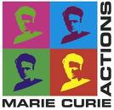
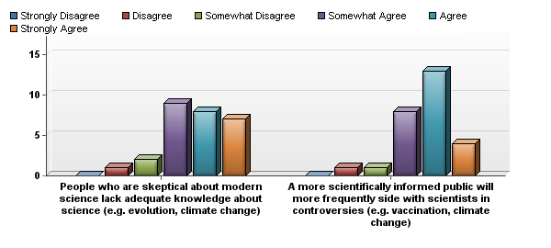
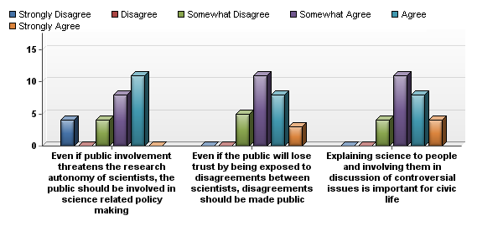
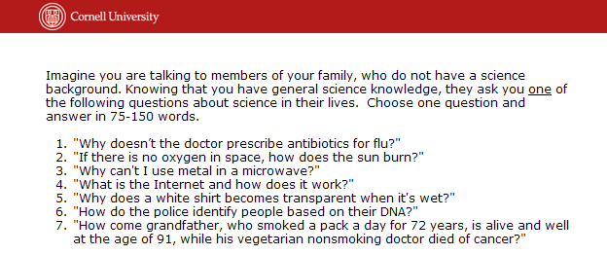
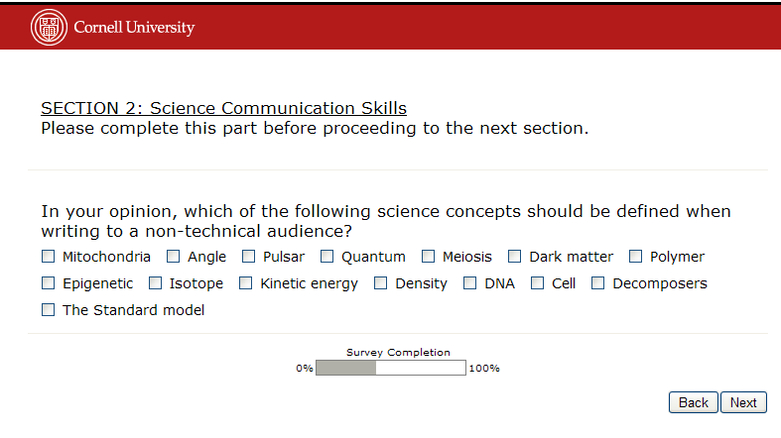
Developing a tool for assessing scientists' views about, knowledge of, and skills in science communication (Abstract # ED51C-0768) Bruce V. Lewenstein, Cornell University, b.lewenstein@cornell.edu Ayelet Baram-Tsabari , Technion – Israel Institute of Technology, ayelet@technion.ac.il
Summary
Recent exhortations call upon scientists to engage in a respectful dialogue with the public, as public values make important contributions to science-related policy issues (Leshner, 2009). One challenge for scientists' public engagement is their lack of training in communicating science with the public (Poliakoff and Webb, 2007) . Many organizations and institutions have created training opportunities for science communication. However, the claims for the efficiency of such training programs are often based on anecdotes and basic self-report evaluations. This situation does not support evidence-based policy regarding media training for scientists (Baram-Tsabari and Lewenstein, 2010).
Standardized assessments will allow comparisons across programs and identification of best practices. Here we describe the development and piloting of a tool for measuring scientists' views about, knowledge of, and skills in science communication. The instrument collects four types of data: (1) background information, (2) communication skills, (3) views about science communication, and (4) knowledge about the context of science communication. It may be used for baseline surveys, pre-post workshop evaluations, or formative assessment during science communication training.
Views about Science Communication
Self confidence in speaking with the media
Attitudes towards science in the media
Responsibility of individual scientists
Benefits and challenges of speaking with the media
The deficit model and attitudes towards public engagement
Number of interactions with the media in the last three years and preferred analogy for science popularization (n = 64, χ² = 39.36, p < 0.05)
Scientists may agree both with statements representing a deficit model (upper panel) and a dialogic or engagement model (lower panel) (n = 73)
Science Communication Skills
Learning goals are established in seven areas: content, knowledge organization, clarity and language, style, analogy, narrative, and dialogue.

