Slide 1




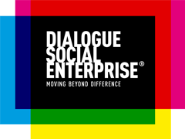
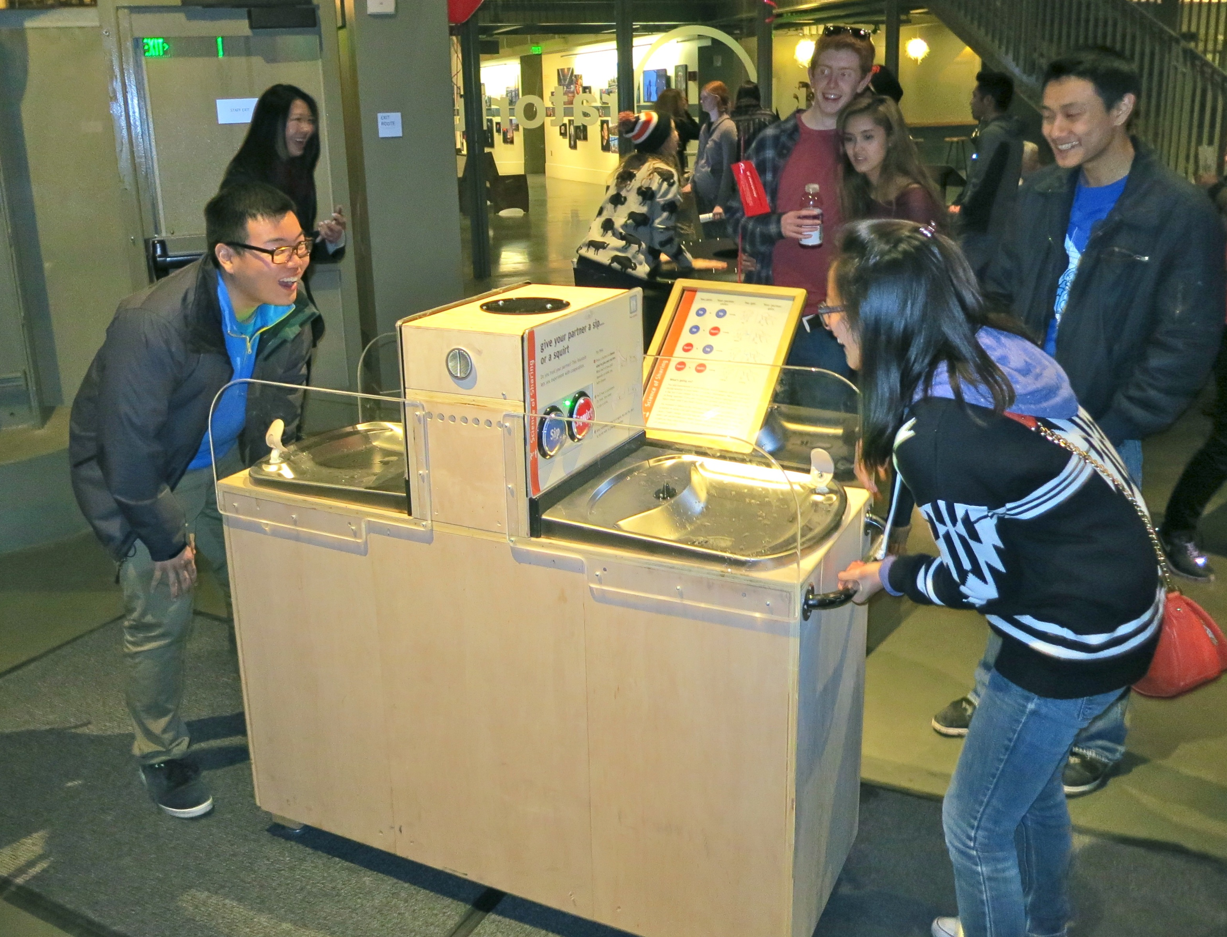

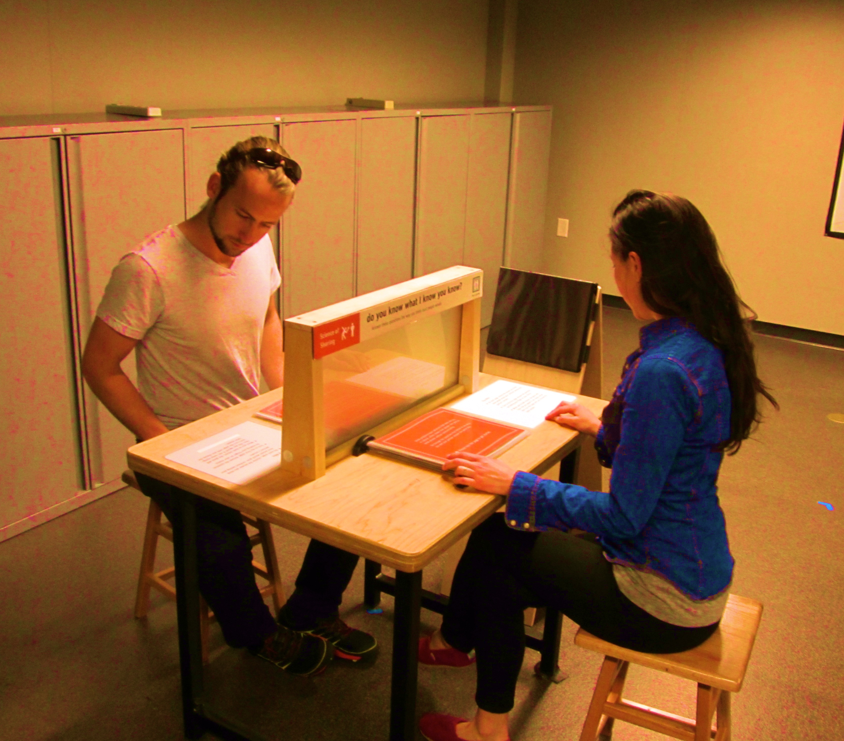
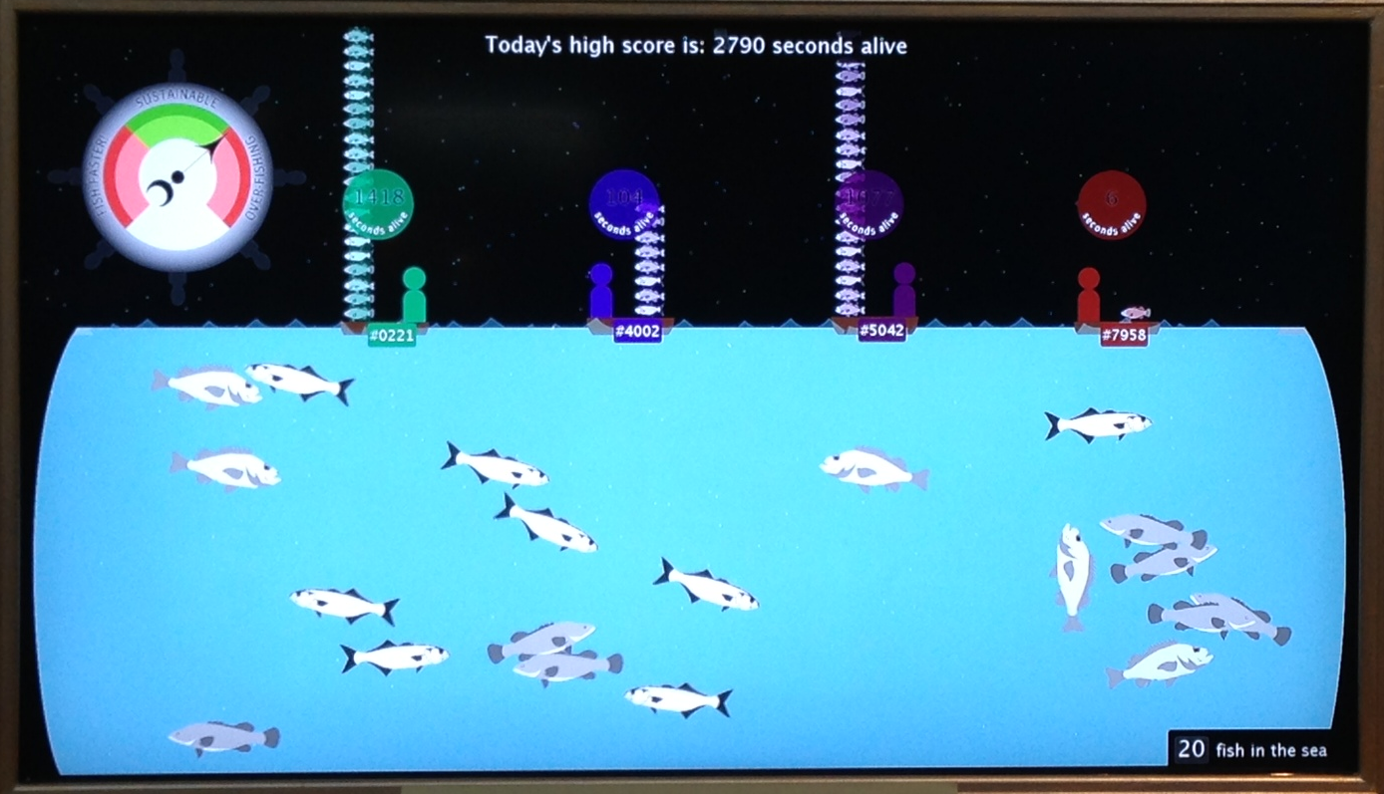
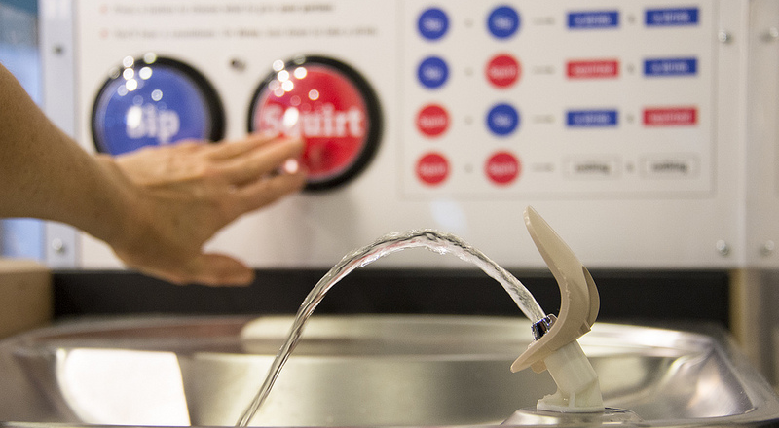
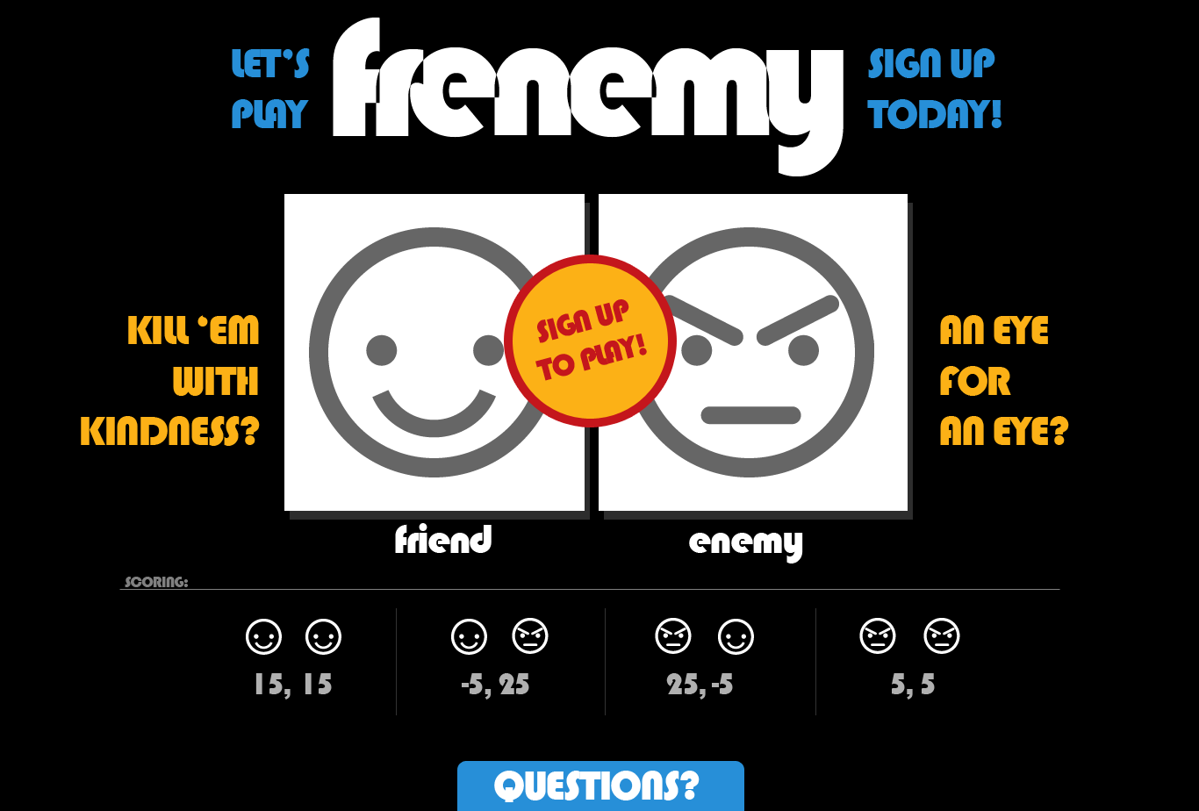
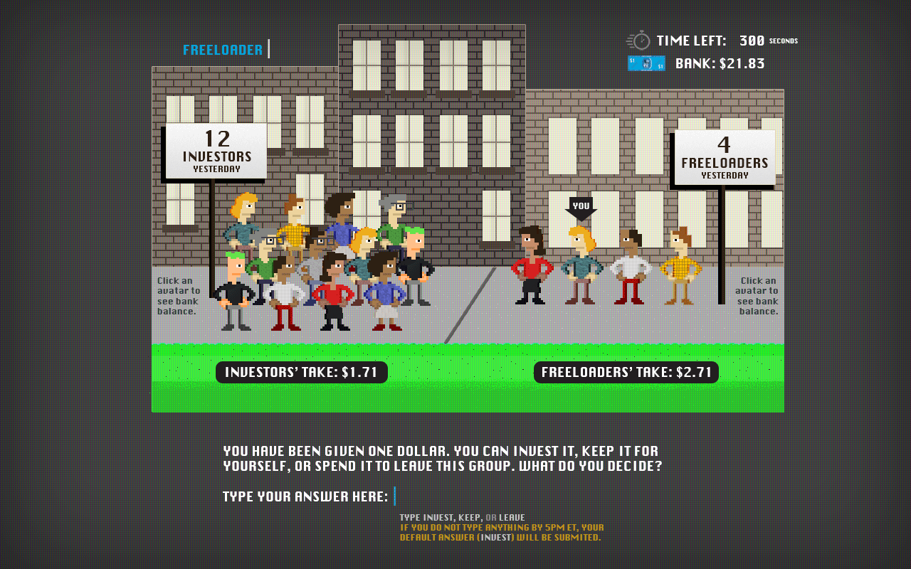
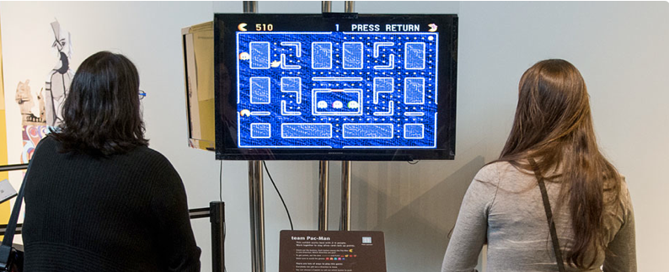
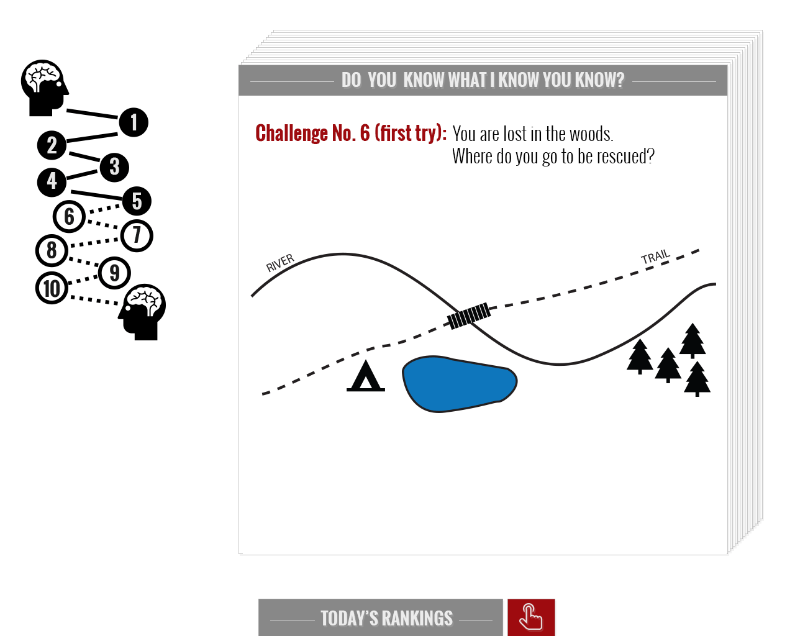
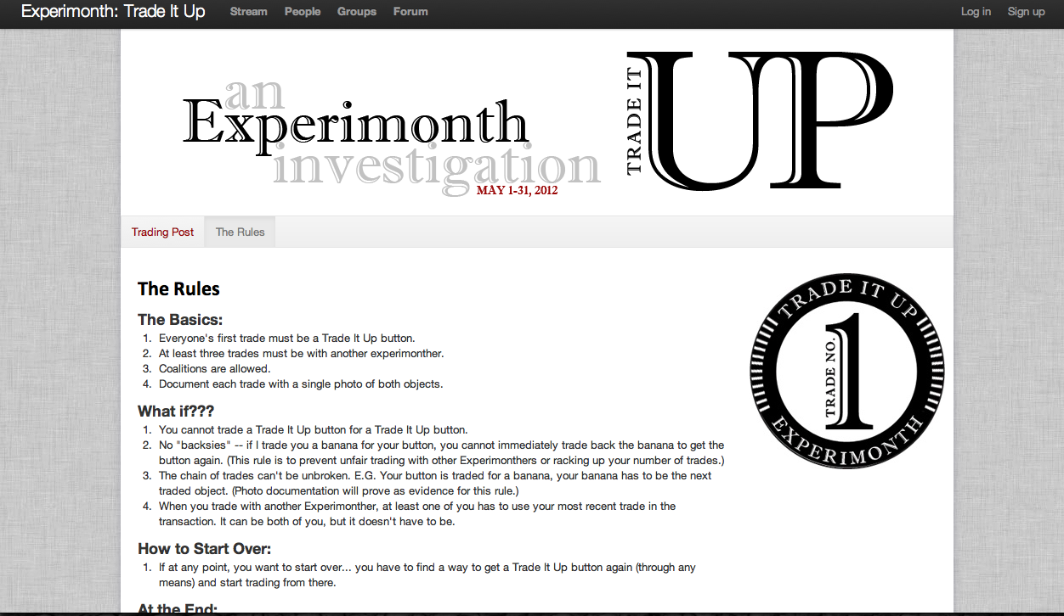
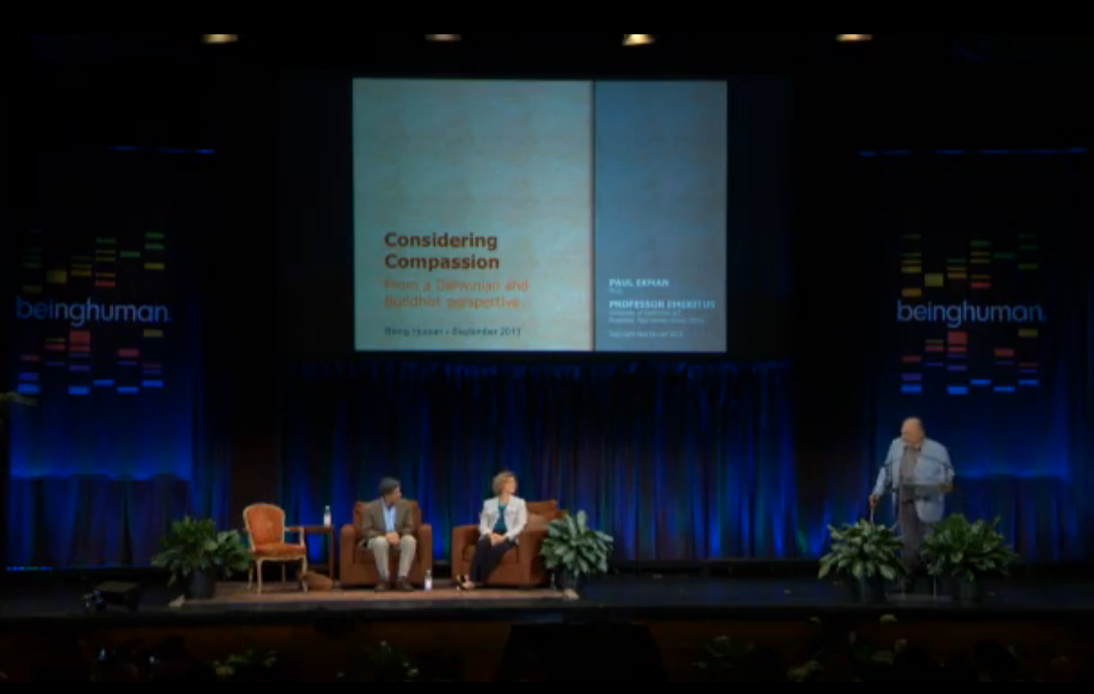
Science of Sharing
Investigating Cooperation, Competition, and Social Interdependence
Project Goals
Foster experimentation with cooperation, resource allocation, and collaborative problem-solving, and awareness of relevant research
Generate discussion of links between everyday social interactions and larger issues of resource depletion and group conflict
Foster metacognitive reflection about decisions
15 Exhibits
Explore social dilemmas around resource sharing
10 Classroom Activities
Experiment with decision-making about cooperation
Research Study
Investigate designs for fostering metacognition
Share resources…or don’t
Judge fairness
Research
Within subjs quasi-experiment with 60 dyads
Test label questions and assess metacognition
Analyzing data now
4 Experimonths
Try month-long challenges to learn about yourself
Interpret others’ motives
Develop trust…or don’t
Friend someone…or not
Pull your weight…or don’t
Evaluation Studies
Assess effectiveness of iterative and final designs
Formative Evaluation
Exhibits formatively evaluated – small & fast studies
Summative Evaluation
  Experimonth evaluation underway
  Exhibition evaluation scheduled for Fall 2014
Collaborate…or not
Find commonalities
Share to gain
Public Forum
Will link individual behavior to societal challenges
Audiences
Museum public 12+ years old
Facebook users 18+ years old
High school students
Institutional partners
Exploratorium: Hugh McDonald, PI; Josh Gutwill, co-PI
Museum of Life and Science: Troy Livingston, co-PI
Dialogue Social Enterprise: Orna Cohen
Heroic Imagination Project: Philip Zimbardo
Advisors and Collaborators
Athena Aktipis Dacher Keltner
Dan Ariely Michael Norton
Mahzarin Banaji Kristina Olson
John Jost Philip Zimbardo
Lessons and Challenges
Maintaining sustainable behavior can become boring
Competition and conflict are emotional experiences
“Scaling up” to real world issues requires several steps
Creating social interactions is hard without mediation
Mindful reflection is difficult in a chaotic museum context
Assessing (silent) metacognition is challenging

