Slide 1
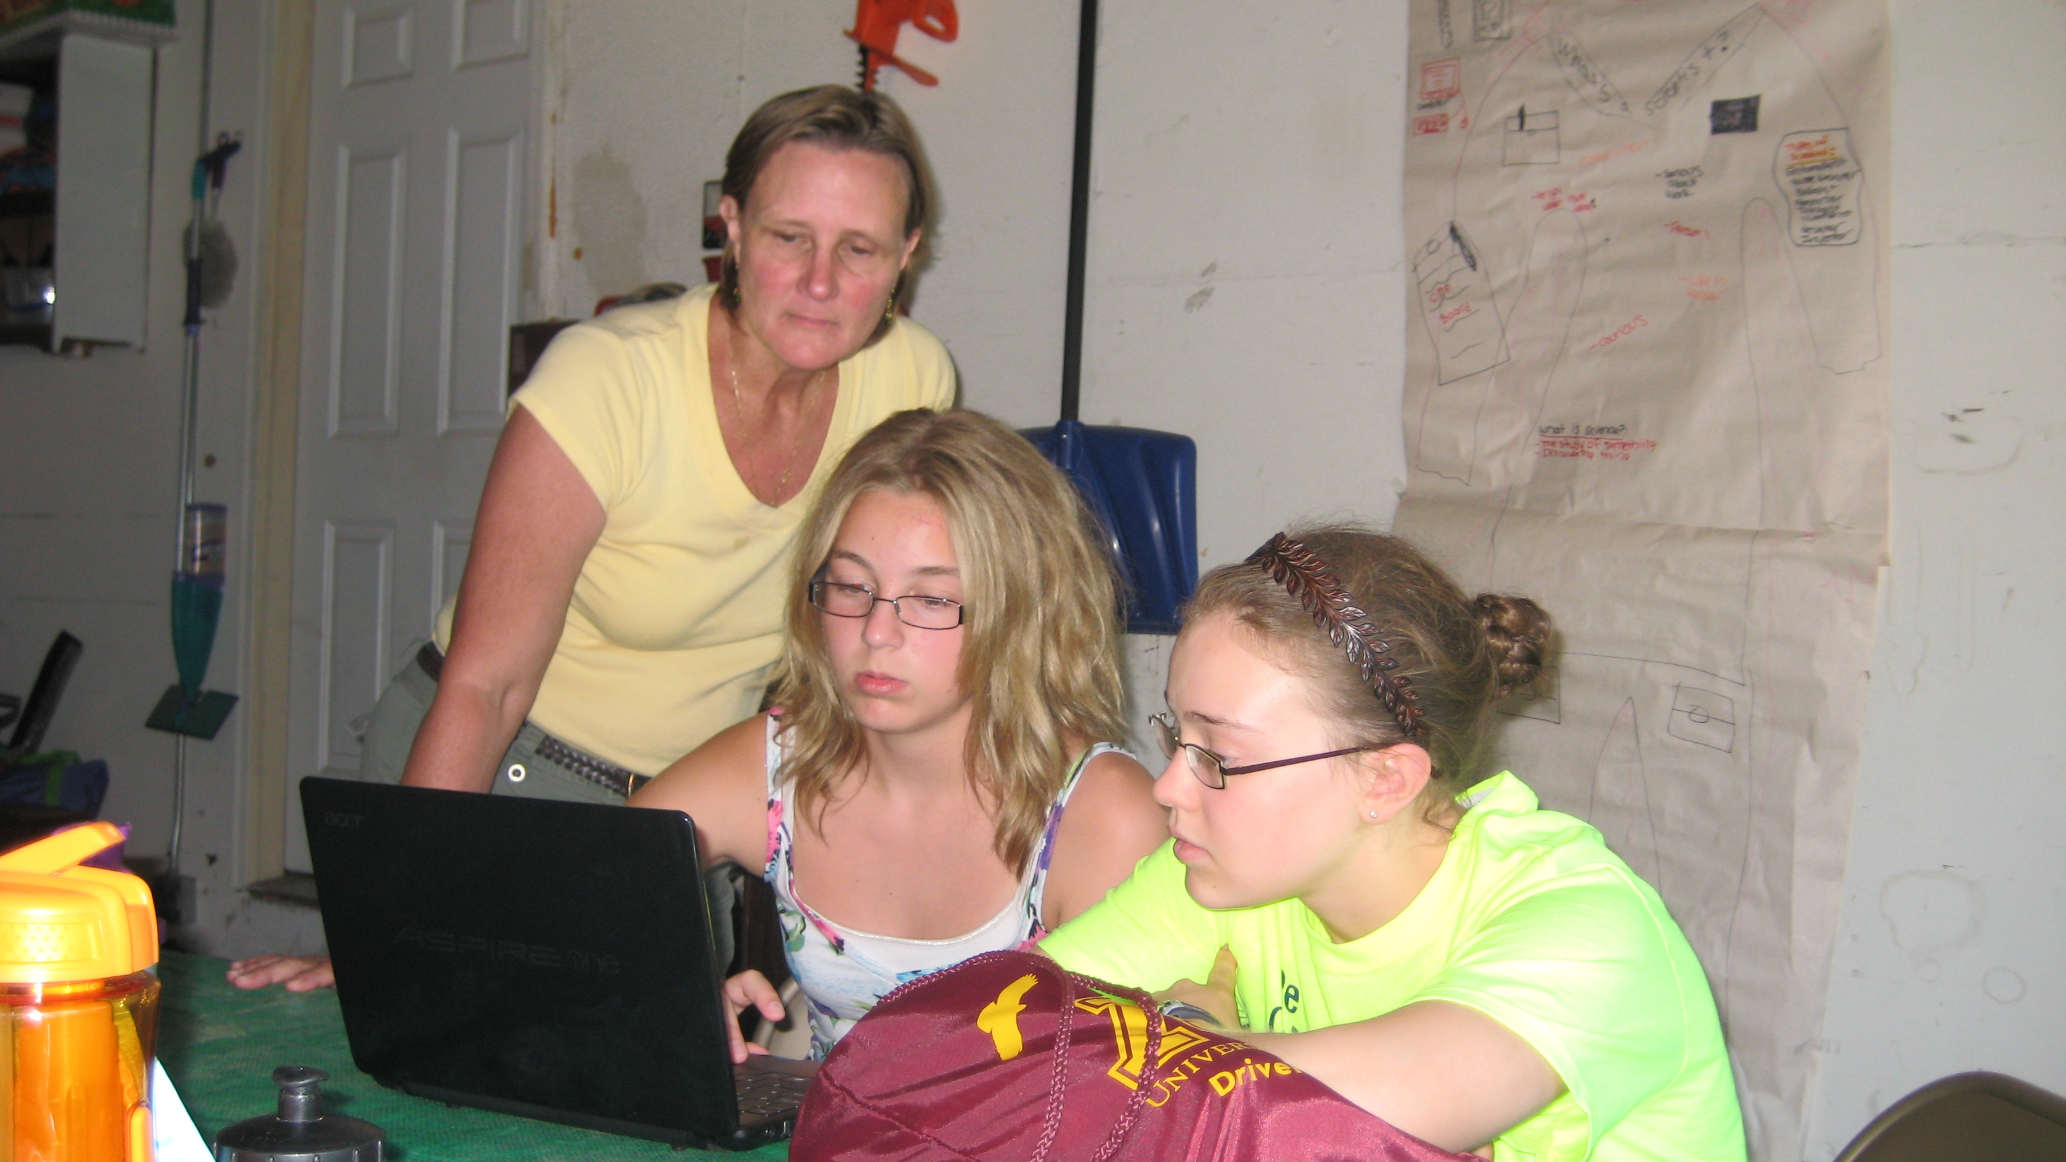
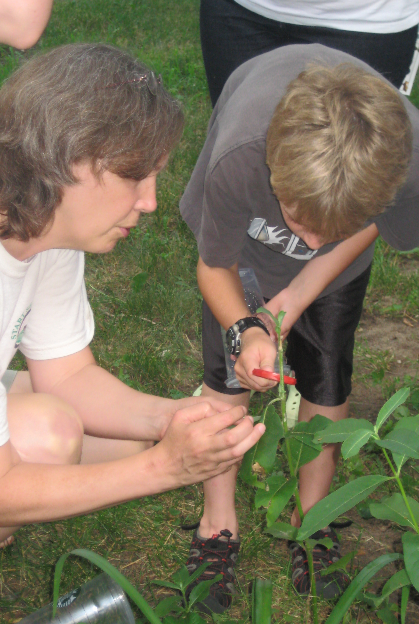
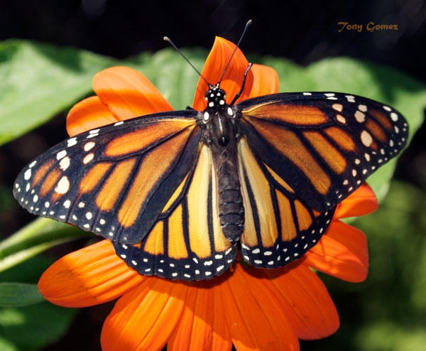
Citizen science sparks independent
scientific investigations
ABSTRACT: Citizen science programs across the country invite the public to participate in scientific research. Through these experiences, participants learn scientific data collection protocols and have opportunities to observe nature, which naturally leads to asking questions about the natural world. A new project in Minnesota is training leaders of youth groups to use citizen science experiences to stimulate curiosity and inspire motivation to design and carry out scientific research projects. This unique program model fosters authentic inquiry in youth age 10-14 outside the traditional school setting, such as 4-H clubs, scout groups, or community youth programs. This poster describes program activities that took place in 2012, which was Year 3 of a five-year, NSF-funded project.
`
Driven to Discover: Inquiry in nonformal settings
During the first three years of the five-year project, participants met regularly with their research teams in parks, schools and other areas to collect citizen science data. Individuals and small groups of youth posed questions based on phenomena experienced during these meetings, then carried out an original inquiry project. All research teams were invited to present their investigations in Fall Research Summits.
OBSERVE
Participating in citizen science projects provides opportunities for youth to observe natural phenomena. Journaling exercises help focus observations and stimulate reflection.
FIGURE 1. 2012, n=98
FIGURE 2. 2012, n=93
QUESTION
Observations naturally trigger curiosity. Youth document questions on an “I Wonder” board, then learn to convert their questions into descriptive, comparative, or correlative questions ready for testing. Mentoring by professional scientists increased participants’ science confidence and exposed youth to science careers.
FIGURE 3. 2012, n=19
INVESTIGATE
Project Goals:
Create training model for adult leaders.
Adult leaders gain skills and knowledge to transfer to youth.
Engage youth in inquiry through citizen science.
Disseminate program model to informal science education audiences.
Youth identify the possible answers to their research question, then design an investigation to gather evidence to support or refute one of their hypotheses. Youth analyze their data and communicate their findings to each other at a state-wide Research Summit in the Fall.
FORMATIVE EVALUATION RESULTS: Preliminary evaluation of the project has shown that the program model leads to changes in skills, attitudes and behaviors of both youth and adult participants. End-of-season focus groups confirmed that many club leaders increased their confidence in facilitating youth inquiry.
AUTHORS: Andrea Lorek Strauss, Extension Educator, Fish, Wildlife and Conservation Education, Karen Oberhauser, Associate Professor, Department of Fisheries, Wildlife and Conservation Biology, Pamela Larson Nippolt, Program Leader, Extension Center for Youth Development, Robert B Blair, Associate Professor, Department of Fisheries, Wildlife and Conservation Biology, Nathan Meyer, Program Leader, Extension Center for Food, Agriculture & Natural Resource Sciences
© 2012, Regents of the University of Minnesota. All rights reserved. This material is based upon work supported by the National Science Foundation under Grant No. 000346525. The University of Minnesota is an equal opportunity educator and employer.

